Slide 1

Superstore Sales & Profit Insights
Priyanshu Prakash
Magadh University
AICTE Internship Student Registration ID) : STU66a2887877ab71721927800
Apply ID: APPLY_172684635366ed959193888
Computer Application 4th year

Slide 2

PROBLEM STATEMENT
The analysis aims to identify high-performing product categories, regions with strong sales, and effective strategies.
By understanding these factors, the store can optimize its operations, expand into new markets, and increase overall sales.

Slide 3
Project Description This project analyzes sales and profit data across different regions, product sub-categories, and states to identify high-performing areas and profitable product segments. 1.High-Performing Regions 2.Top Product Sub-Categories 3.Sales Performance by State 4.Average Profit by Product

Slide 4

WHO ARE THE END USERS?
This project provides valuable insights that can support decision-making across departments, ultimately benefiting the entire company by aligning strategies for growth and efficiency.
End Users of the Project: Sales Department, Regional Managers, Finance Department

Slide 5

Technology Used
Python: The primary programming language used for data analysis and visualization in this project.
Pandas: A powerful data manipulation library in Python, used for cleaning, organizing, and analyzing the sales and profit data.
Matplotlib: A Python plotting library used to create the bar charts and visualizations
Seaborn: A data visualization library built on top of Matplotlib, used for creating visually appealing

Slide 6
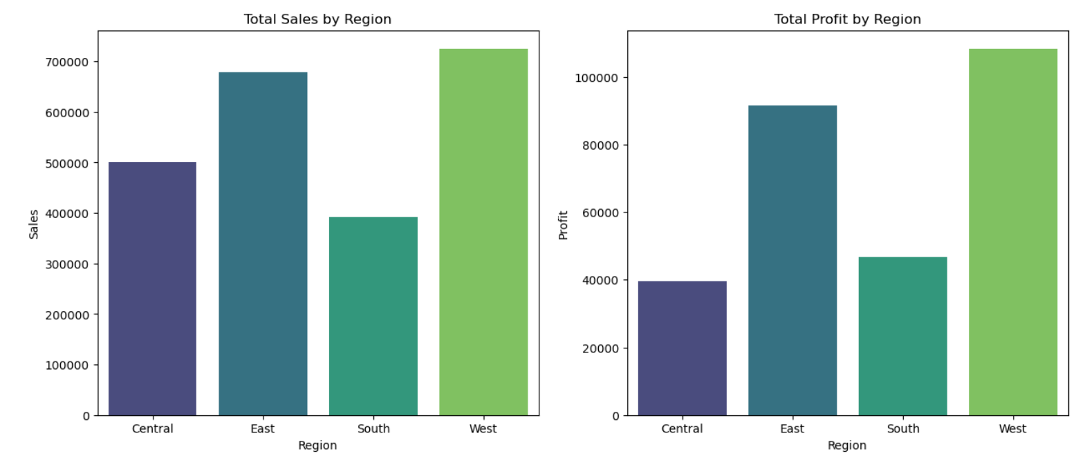
RESULTS
The bar charts show total sales and profit by region. The West region has the highest sales and profit, while the Central region has the lowest.
Demo Link

Slide 7
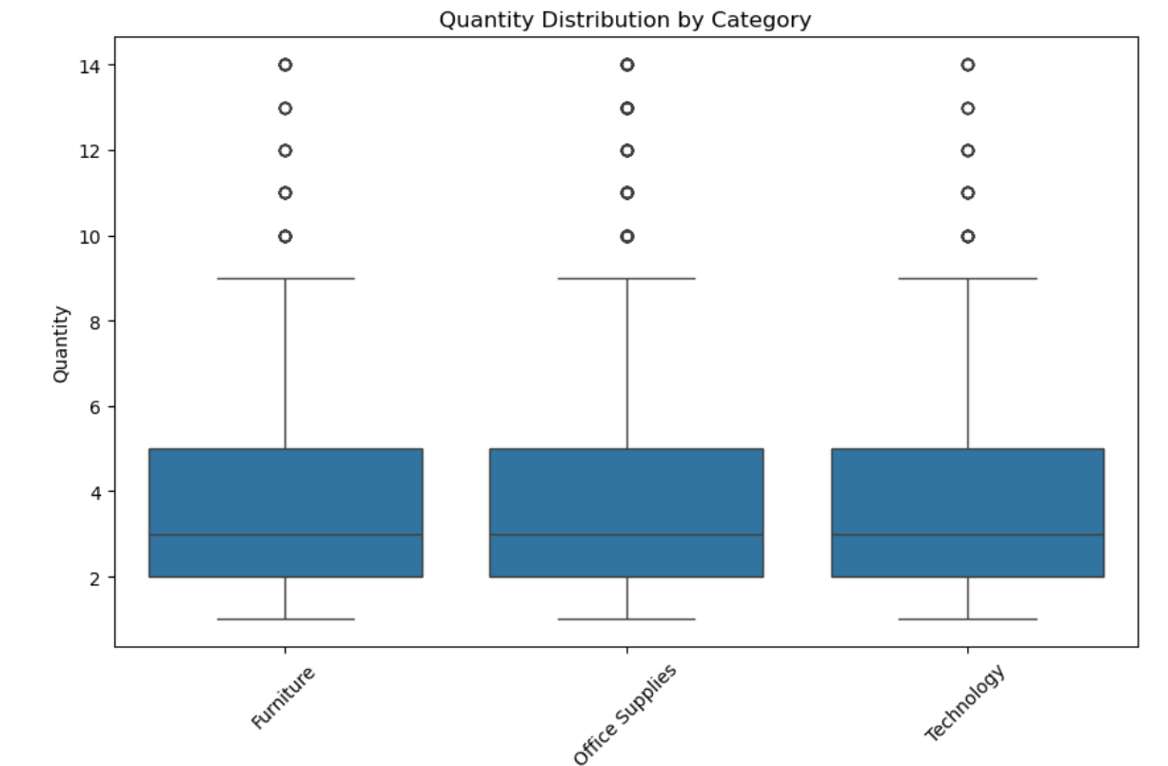
Quantity Distribution
The box plot shows a similar distribution of quantities across Furniture, Office Supplies, and Technology categories, with some outliers present in each category.

Slide 8
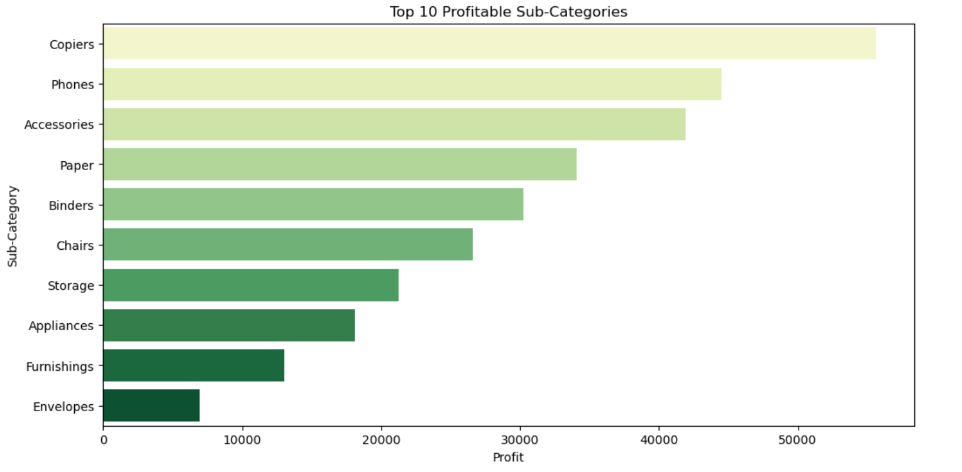
Top 10 Profitable Sub-Categories
Copiers are the most profitable sub-category,
Phones and Accessories follow,
but with a noticeable profit gap compared to copiers.

Slide 9
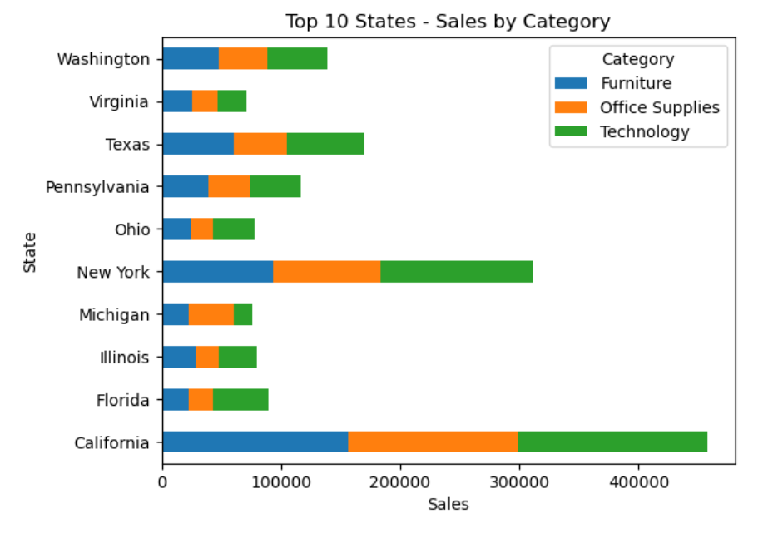
Top 10 States
California has the highest sales across all categories, followed by New York and Texas.
Technology sales are prominent across most states, but California leads in all categories (Furniture, Office Supplies, Technology).

Slide 10
Thank you
Thank you for your time and consideration; we look forward to your feedback and insights!
.
.

